Slide 1
Definition of business process
Process 1 – Administration of a Blood transfusion
The process outlines the steps involved in analyzing the patient’s blood group and crossmatch, followed by the administration of the blood transfusion.

Slide 2
Patient requiring a blood / blood products transfusion
GSRN
CPOE for blood/ blood products required for patient
CPOE: Computerized Provider Order Entry

Slide 3
Patient requiring a blood / blood products transfusion
GSRN
GSRN/SRIN/GLN
CPOE for blood/ blood products required for patient
Positive patient identity confirmed by HCP by scanning patient wristband and gaining verbal confirmation
CPOE: Computerized Provider Order Entry
HCP: Healthcare professionals

Slide 4
Patient requiring a blood / blood products transfusion
GSRN
GSRN/SRIN/GLN
GSRN/SRIN/GLN
CPOE for blood/ blood products required for patient
Positive patient identity confirmed by HCP by scanning patient wristband and gaining verbal confirmation
Blood sample x2 taken from patient and labelled at bedside
CPOE: Computerized Provider Order Entry
HCP: Healthcare professionals

Slide 5
Patient requiring a blood / blood products transfusion
GSRN
GSRN/SRIN/GLN
GSRN/SRIN/GLN
Blood sample taken to the laboratory for processing
CPOE for blood/ blood products required for patient
Positive patient identity confirmed by HCP by scanning patient wristband and gaining verbal confirmation
Blood sample x2 taken from patient and labelled at bedside
CPOE: Computerized Provider Order Entry
HCP: Healthcare professionals

Slide 6
Patient requiring a blood / blood products transfusion
GSRN
GSRN/SRIN/GLN
GSRN/SRIN/GLN
Blood sample taken to the laboratory for processing
GSRN/SRIN
CPOE for blood/ blood products required for patient
Positive patient identity confirmed by HCP by scanning patient wristband and gaining verbal confirmation
Blood sample x2 taken from patient and labelled at bedside
Two samples identified and checked that both are labelled identically
CPOE: Computerized Provider Order Entry
HCP: Healthcare professionals

Slide 7
Patient requiring a blood / blood products transfusion
GSRN
GSRN/SRIN/GLN
GSRN/SRIN/GLN
Blood sample taken to the laboratory for processing
GSRN/SRIN
Group and save takes place to match blood group/ antibodies and rhesus factor
CPOE for blood/ blood products required for patient
Positive patient identity confirmed by HCP by scanning patient wristband and gaining verbal confirmation
Blood sample x2 taken from patient and labelled at bedside
Two samples identified and checked that both are labelled identically
CPOE: Computerized Provider Order Entry
HCP: Healthcare professionals

Slide 8
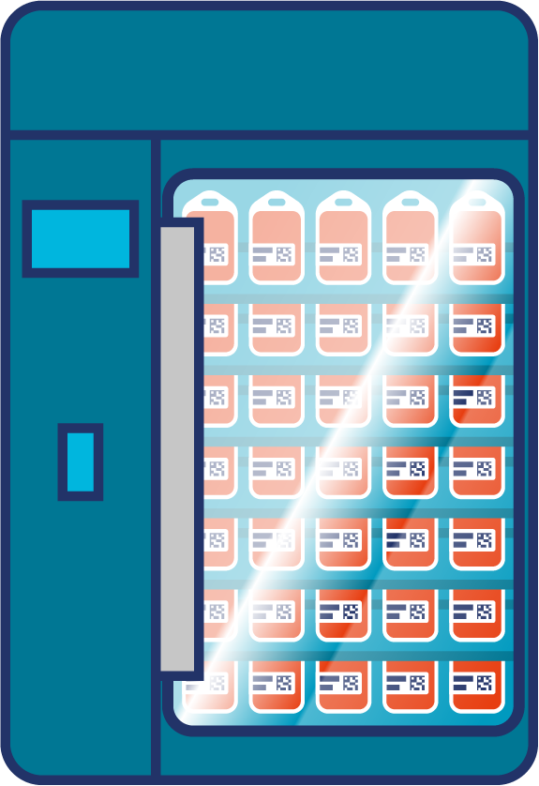
Patient requiring a blood / blood products transfusion
GSRN
GSRN/SRIN/GLN
GSRN/SRIN/GLN
Blood sample taken to the laboratory for processing
GSRN/SRIN
Group and save takes place to match blood group/ antibodies and rhesus factor
Blood arrives from Blood bank into hospital refrigeration
CPOE for blood/ blood products required for patient
Positive patient identity confirmed by HCP by scanning patient wristband and gaining verbal confirmation
Blood sample x2 taken from patient and labelled at bedside
Two samples identified and checked that both are labelled identically
CPOE: Computerized Provider Order Entry
HCP: Healthcare professionals

Slide 9
Patient requiring a blood / blood products transfusion
GSRN
GSRN/SRIN/GLN
GSRN/SRIN/GLN
Blood sample taken to the laboratory for processing
GSRN/SRIN
Group and save takes place to match blood group/ antibodies and rhesus factor
Blood arrives from Blood bank into hospital refrigeration
CPOE for blood/ blood products required for patient
Positive patient identity confirmed by HCP by scanning patient wristband and gaining verbal confirmation
Blood sample x2 taken from patient and labelled at bedside
Two samples identified and checked that both are labelled identically
X2 clinical staff collect blood from blood bank and return to patient for administration
CPOE: Computerized Provider Order Entry
HCP: Healthcare professionals

Slide 10
Patient requiring a blood / blood products transfusion
GSRN
GSRN/SRIN/GLN
GSRN/SRIN/GLN
Blood sample taken to the laboratory for processing
GSRN/SRIN
Group and save takes place to match blood group/ antibodies and rhesus factor
Blood arrives from Blood bank into hospital refrigeration
CPOE for blood/ blood products required for patient
Positive patient identity confirmed by HCP by scanning patient wristband and gaining verbal confirmation
Blood sample x2 taken from patient and labelled at bedside
Two samples identified and checked that both are labelled identically
GSRN/SRIN/GLN
X2 clinical staff collect blood from blood bank and return to patient for administration
Positive patient identification by both HCP by scanning the wristband and gaining verbal confirmation
CPOE: Computerized Provider Order Entry
HCP: Healthcare professionals

Slide 11
Patient requiring a blood / blood products transfusion
GSRN
GSRN/SRIN/GLN
GSRN/SRIN/GLN
Blood sample taken to the laboratory for processing
GSRN/SRIN
Group and save takes place to match blood group/ antibodies and rhesus factor
Blood arrives from Blood bank into hospital refrigeration
CPOE for blood/ blood products required for patient
Positive patient identity confirmed by HCP by scanning patient wristband and gaining verbal confirmation
Blood sample x2 taken from patient and labelled at bedside
Two samples identified and checked that both are labelled identically
GSRN/SRIN/GLN
GSRN/SRIN/GLN
X2 clinical staff collect blood from blood bank and return to patient for administration
HCP x2 Verify the details on the blood product and verify these are correct and completes vital observations as a baseline
Positive patient identification by both HCP by scanning the wristband and gaining verbal confirmation
CPOE: Computerized Provider Order Entry
HCP: Healthcare professionals

Slide 12
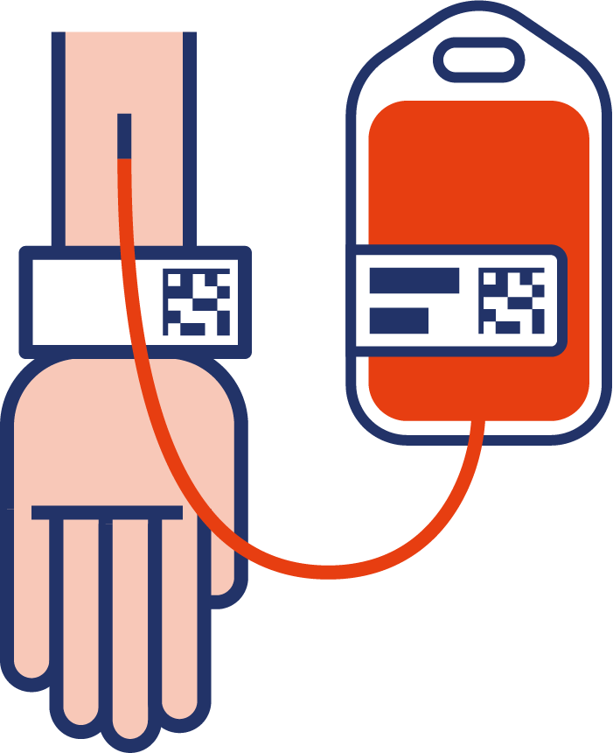
Patient requiring a blood / blood products transfusion
GSRN
GSRN/SRIN/GLN
GSRN/SRIN/GLN
Blood sample taken to the laboratory for processing
GSRN/SRIN
Group and save takes place to match blood group/ antibodies and rhesus factor
Blood arrives from Blood bank into hospital refrigeration
CPOE for blood/ blood products required for patient
Positive patient identity confirmed by HCP by scanning patient wristband and gaining verbal confirmation
Blood sample x2 taken from patient and labelled at bedside
Two samples identified and checked that both are labelled identically
GSRN/SRIN/GLN
GSRN/SRIN/GLN
GSRN/SRIN/GLN
X2 clinical staff collect blood from blood bank and return to patient for administration
HCP connects Intra venous infusion and stays with the patient
HCP x2 Verify the details on the blood product and verify these are correct and completes vital observations as a baseline
Positive patient identification by both HCP by scanning the wristband and gaining verbal confirmation
CPOE: Computerized Provider Order Entry
HCP: Healthcare professionals

Slide 13
Patient requiring a blood / blood products transfusion
GSRN
GSRN/SRIN/GLN
GSRN/SRIN/GLN
Blood sample taken to the laboratory for processing
GSRN/SRIN
Group and save takes place to match blood group/ antibodies and rhesus factor
Blood arrives from Blood bank into hospital refrigeration
CPOE for blood/ blood products required for patient
Positive patient identity confirmed by HCP by scanning patient wristband and gaining verbal confirmation
Blood sample x2 taken from patient and labelled at bedside
Two samples identified and checked that both are labelled identically
GSRN/SRIN/GLN
GSRN/SRIN/GLN
GSRN/SRIN/GLN
GSRN/SRIN/GLN
X2 clinical staff collect blood from blood bank and return to patient for administration
Vital observations are taken every 15mins and patient observed for signs of a reaction
HCP connects Intra venous infusion and stays with the patient
HCP x2 Verify the details on the blood product and verify these are correct and completes vital observations as a baseline
Positive patient identification by both HCP by scanning the wristband and gaining verbal confirmation
CPOE: Computerized Provider Order Entry
HCP: Healthcare professionals

Slide 14
Patient requiring a blood / blood products transfusion
GSRN
GSRN/SRIN/GLN
GSRN/SRIN/GLN
Blood sample taken to the laboratory for processing
GSRN/SRIN
Group and save takes place to match blood group/ antibodies and rhesus factor
Blood arrives from Blood bank into hospital refrigeration
CPOE for blood/ blood products required for patient
Positive patient identity confirmed by HCP by scanning patient wristband and gaining verbal confirmation
Blood sample x2 taken from patient and labelled at bedside
Two samples identified and checked that both are labelled identically
Transfusion complete
GSRN/SRIN/GLN
GSRN/SRIN/GLN
GSRN/SRIN/GLN
GSRN/SRIN/GLN
X2 clinical staff collect blood from blood bank and return to patient for administration
Vital observations are taken every 15mins and patient observed for signs of a reaction
HCP connects Intra venous infusion and stays with the patient
HCP x2 Verify the details on the blood product and verify these are correct and completes vital observations as a baseline
Positive patient identification by both HCP by scanning the wristband and gaining verbal confirmation
CPOE: Computerized Provider Order Entry
HCP: Healthcare professionals

Slide 15
Benefits
Clinical
Non clinical
Improved patient safety (serious untoward incidents) and outcomes by preventing errors.
Patients only need a single sample taken, reducing discomfort and inconvenience.
No delays in results and treatment due to error elimination.
Reduced risk of wrong results leading to incorrect diagnosis.
Electronic ordering and collection eliminates paper order readability and transcription incidents.
Reduced errors related to pathology collections.
Better care for patients through reduced repeated processes and costs.
Automated process reduces lab data entry efforts.
Clear patient identification reduces errors in labelling.
Reduced amount of testing needed due to incorrect labelling, saving time and resources.
Significant reduction in pathology collection errors.
Enhancing job satisfaction and efficiency.

