Slide 1
Definition of business process
Process 1 – The process of a patient undergoing imaging
The imaging process enables healthcare professionals to have views of the patient to aid

Slide 2
Imaging ( Xray/MRI/CT/US)
Elective access

Slide 3
Imaging ( Xray/MRI/CT/US)
Elective access
Emergency access
Linked to ED emergency patient

Slide 4
Imaging ( Xray/MRI/CT/US)
Elective access
Patient referral
Emergency access
Linked to ED emergency patient

Slide 5
Imaging ( Xray/MRI/CT/US)
Elective access
Patient referral
GSRN/SRIN/GLN
Positive Patient identification takes place when patient arrives in department
Emergency access
Linked to ED emergency patient

Slide 6
Imaging ( Xray/MRI/CT/US)
*IHE radiology significant part of the sharing of imaging
Elective access
Patient referral
GSRN/SRIN/GLN
Positive Patient identification takes place when patient arrives in department
Emergency access
Linked to ED emergency patient
*IHE Radiology was formed in 1998 to address issues of interoperability and information sharing that impact the quality of care in medical imaging. It has developed and documented standards-based solutions to these problems and organized testing and education to foster their adoption.
Imaging

Slide 7
Imaging ( Xray/MRI/CT/US)
*IHE radiology significant part of the sharing of imaging
MRI
GSRN/SRIN/GLN
Elective access
Patient referral
GSRN/SRIN/GLN
Positive Patient identification takes place when patient arrives in department
Emergency access
Linked to ED emergency patient
*IHE Radiology was formed in 1998 to address issues of interoperability and information sharing that impact the quality of care in medical imaging. It has developed and documented standards-based solutions to these problems and organized testing and education to foster their adoption.
Imaging

Slide 8
Imaging ( Xray/MRI/CT/US)
*IHE radiology significant part of the sharing of imaging
MRI
GSRN/SRIN/GLN
MRI checklist Implantable (GTIN) MRI Safe/
Not Safe
Elective access
Patient referral
GSRN/SRIN/GLN
Positive Patient identification takes place when patient arrives in department
Emergency access
Linked to ED emergency patient
*IHE Radiology was formed in 1998 to address issues of interoperability and information sharing that impact the quality of care in medical imaging. It has developed and documented standards-based solutions to these problems and organized testing and education to foster their adoption.
Imaging

Slide 9
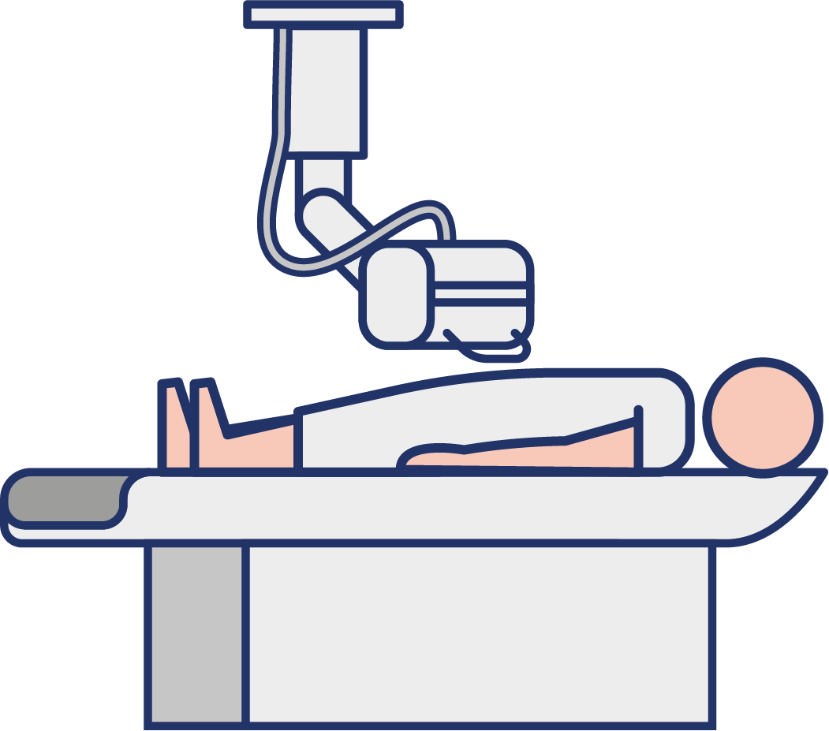
Imaging ( Xray/MRI/CT/US)
*IHE radiology significant part of the sharing of imaging
MRI
GSRN/SRIN/GLN
MRI checklist Implantable (GTIN) MRI Safe/
Not Safe
Elective access
XRAY
GSRN/SRIN/GLN
Patient referral
GSRN/SRIN/GLN
Positive Patient identification takes place when patient arrives in department
Emergency access
Linked to ED emergency patient
*IHE Radiology was formed in 1998 to address issues of interoperability and information sharing that impact the quality of care in medical imaging. It has developed and documented standards-based solutions to these problems and organized testing and education to foster their adoption.
Imaging

Slide 10
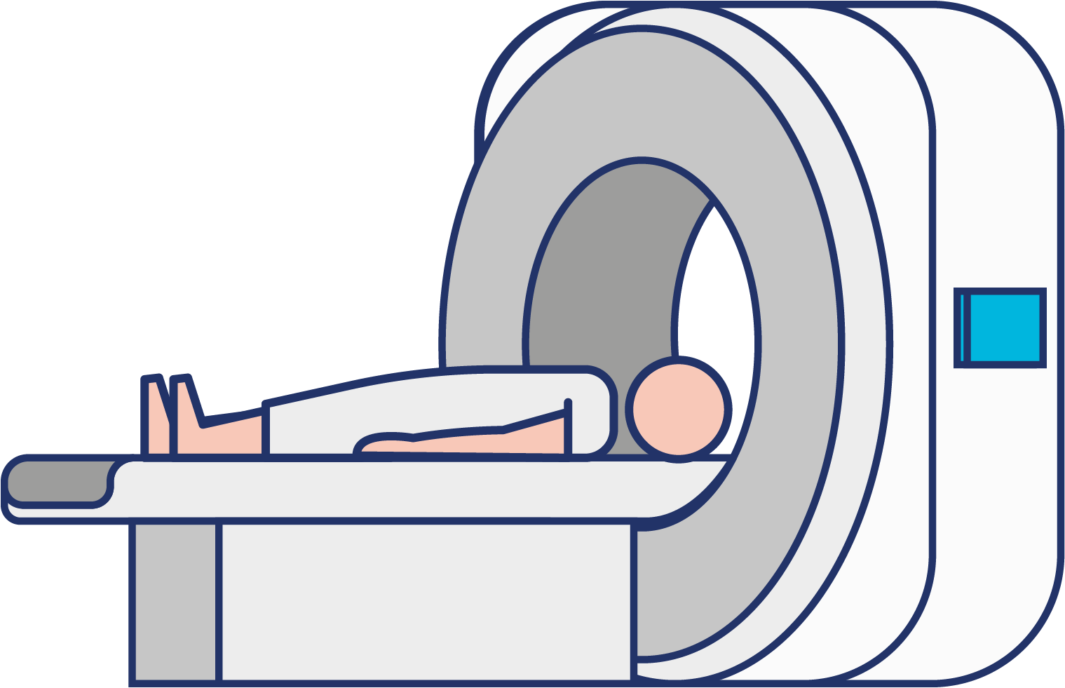
Imaging ( Xray/MRI/CT/US)
*IHE radiology significant part of the sharing of imaging
MRI
GSRN/SRIN/GLN
MRI checklist Implantable (GTIN) MRI Safe/
Not Safe
Elective access
XRAY
GSRN/SRIN/GLN
Patient referral
GSRN/SRIN/GLN
CT
Positive Patient identification takes place when patient arrives in department
GSRN/SRIN/GLN
Emergency access
Linked to ED emergency patient
*IHE Radiology was formed in 1998 to address issues of interoperability and information sharing that impact the quality of care in medical imaging. It has developed and documented standards-based solutions to these problems and organized testing and education to foster their adoption.
Imaging

Slide 11
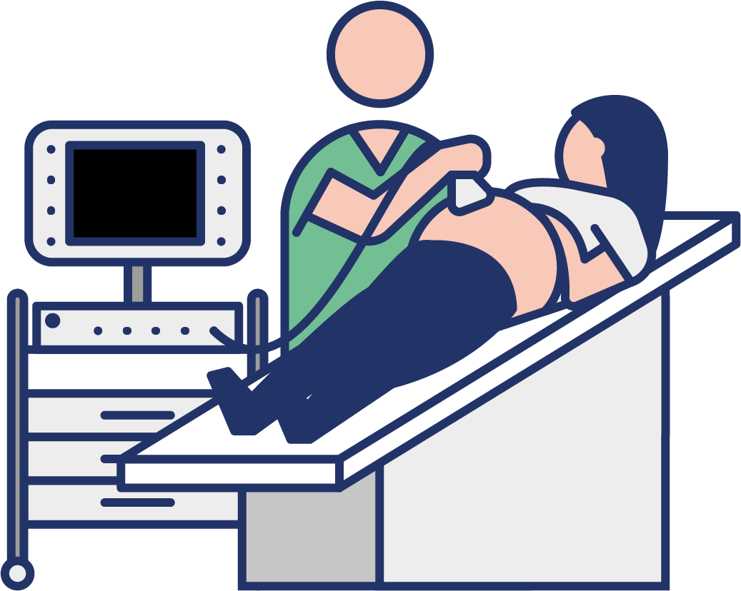
Imaging ( Xray/MRI/CT/US)
*IHE radiology significant part of the sharing of imaging
MRI
GSRN/SRIN/GLN
MRI checklist Implantable (GTIN) MRI Safe/
Not Safe
Elective access
XRAY
GSRN/SRIN/GLN
Patient referral
GSRN/SRIN/GLN
CT
Positive Patient identification takes place when patient arrives in department
GSRN/SRIN/GLN
Emergency access
Linked to ED emergency patient
ULTRASOUND
GSRN/SRIN/GLN
*IHE Radiology was formed in 1998 to address issues of interoperability and information sharing that impact the quality of care in medical imaging. It has developed and documented standards-based solutions to these problems and organized testing and education to foster their adoption.
Imaging

Slide 12
Imaging ( Xray/MRI/CT/US)
*IHE radiology significant part of the sharing of imaging
MRI
GSRN/SRIN/GLN
MRI checklist Implantable (GTIN) MRI Safe/
Not Safe
Elective access
XRAY
GSRN/SRIN/GLN
Patient referral
GSRN/SRIN/GLN
CT
GSRN/GDTI
Positive Patient identification takes place when patient arrives in department
GSRN/SRIN/GLN
All imaging reported by radiologists and a report generated to aid diagnosis by doctor
Emergency access
Linked to ED emergency patient
ULTRASOUND
GSRN/SRIN/GLN
*IHE Radiology was formed in 1998 to address issues of interoperability and information sharing that impact the quality of care in medical imaging. It has developed and documented standards-based solutions to these problems and organized testing and education to foster their adoption.
Imaging

Slide 13
Benefits
Clinical
Enhanced Patient Safety:
Reduces the risk of administering incorrect treatments or procedures.
Ensures that the correct patient receives the appropriate imaging minimizing potential radiation exposure.
Prevents inaccurate data / images in medical records, which can result in misdiagnoses or inappropriate treatments.
Minimizes the occurrence of repeat X-rays due to identification errors, saving time and resources.

